Slide 1
IMPLEMENTATION OF SIC/XE 2 PASS ASSEMBLER
(Milestone 3)

Slide 2



Team 8
1. Harika Andugula
2. Manasi Gupta
3. Shravanthi Bhoopalam Sudharshan
4. Akansha Jajodia

Slide 3
Introduction
Application programs focus on solving a certain problem and are machine independent
System programs support operation and use of the computer related to the architecture of the machine
We need a universal architecture to study the nuances of System Software
SIC - Simplified Instructional Computer is hypothetical computer that includes hardware features generally found in computers

Slide 4
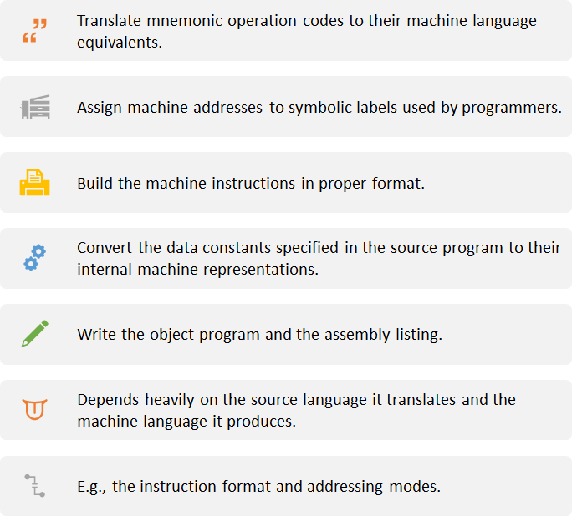
Objective

Slide 5
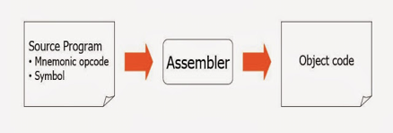
SIC/XE ASSEMBLER
Utility program to convert Assembly language into executable machine code
Assembler goes through the program one line at a time and generates machine code for that instruction

Slide 6
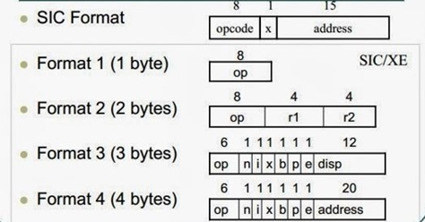
SIC/XE Architecture
The total Memory size is 1MB. This is Byte addressable machine.
It contains 9 registers. Each register is 24 bits in length.
Its data Format consist of 8-bit Character, 24-bit Integer and 48-bit Float data types
Its Instruction Format has 4 formats

Slide 7
SIC/XE Architecture
Its Instruction Set consists of Register specific, Supervisor Call instructions, Load, Store, Arithmetic operation.
Following are its Addressing Modes - Direct, Indirect, Base relative, Program counter relative addressing.
Its Input & Output contains Read Data, Write Data instructions and Test Device . SIO, TIO, HIO instructions to Start, Test, Halt I/O channel operation. I / O channels are used to perform IO while other instructions are performed by the CPU.

Slide 8
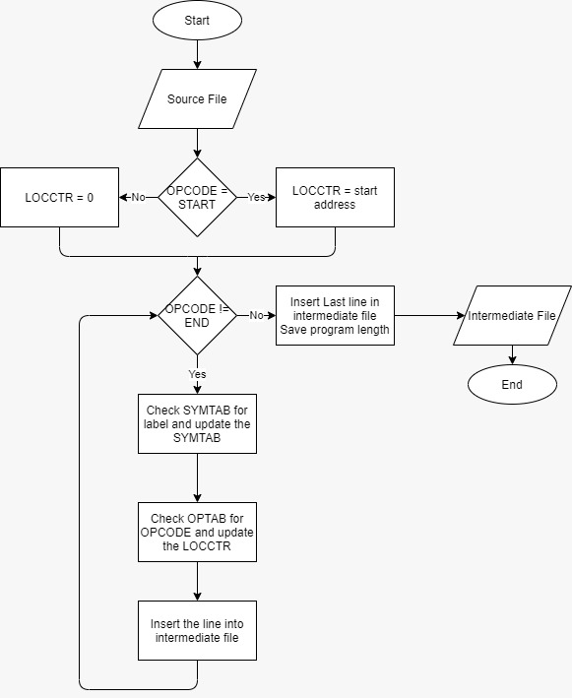
One-Pass Assemblers
Passes over the source file exactly once
Collects labels, resolves future references and performs assembly in one pass
Challenge: to resolve future label references and assembles code in one pass

Slide 9
Two Pass Assembler
▪Pass 1:
Scans the program looking for symbols, labels, variables etc.,
Passes through the instructions in sequence looking for symbol addresses.
Create a symbol and literal table. Keeps track of location counter.
Process Pseudo operations.
Pass 2:
Assembles the code to generate object code
In this process, symbolic addresses are replaced with absolute addresses
Symbolic opcodes are replaced with binary opcodes
Generate data values

Slide 10
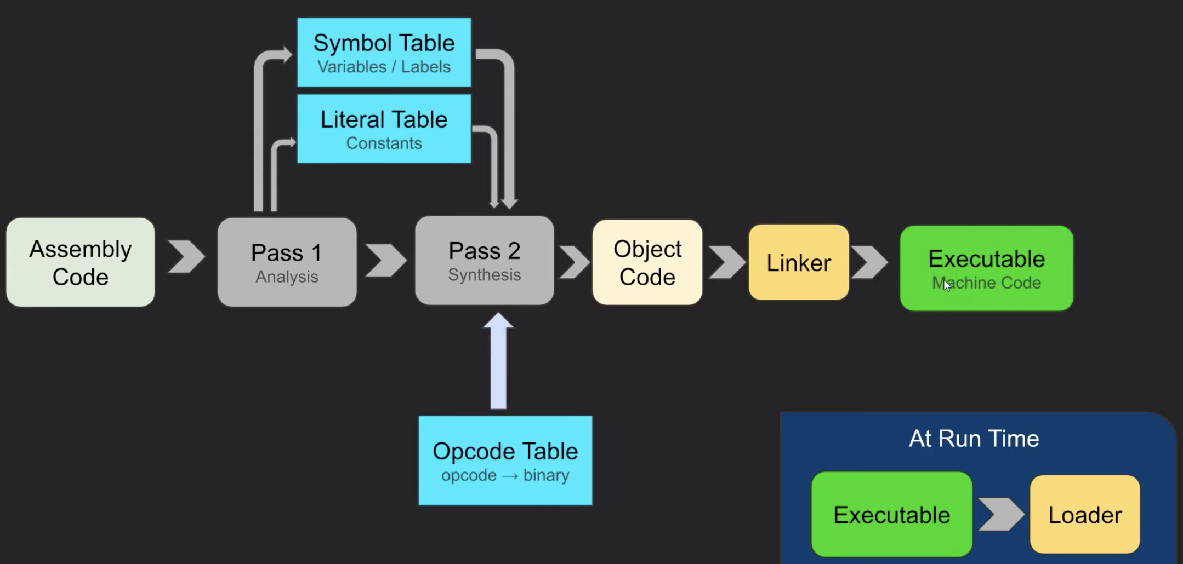
Architecture of Two Pass Assembler

Slide 11
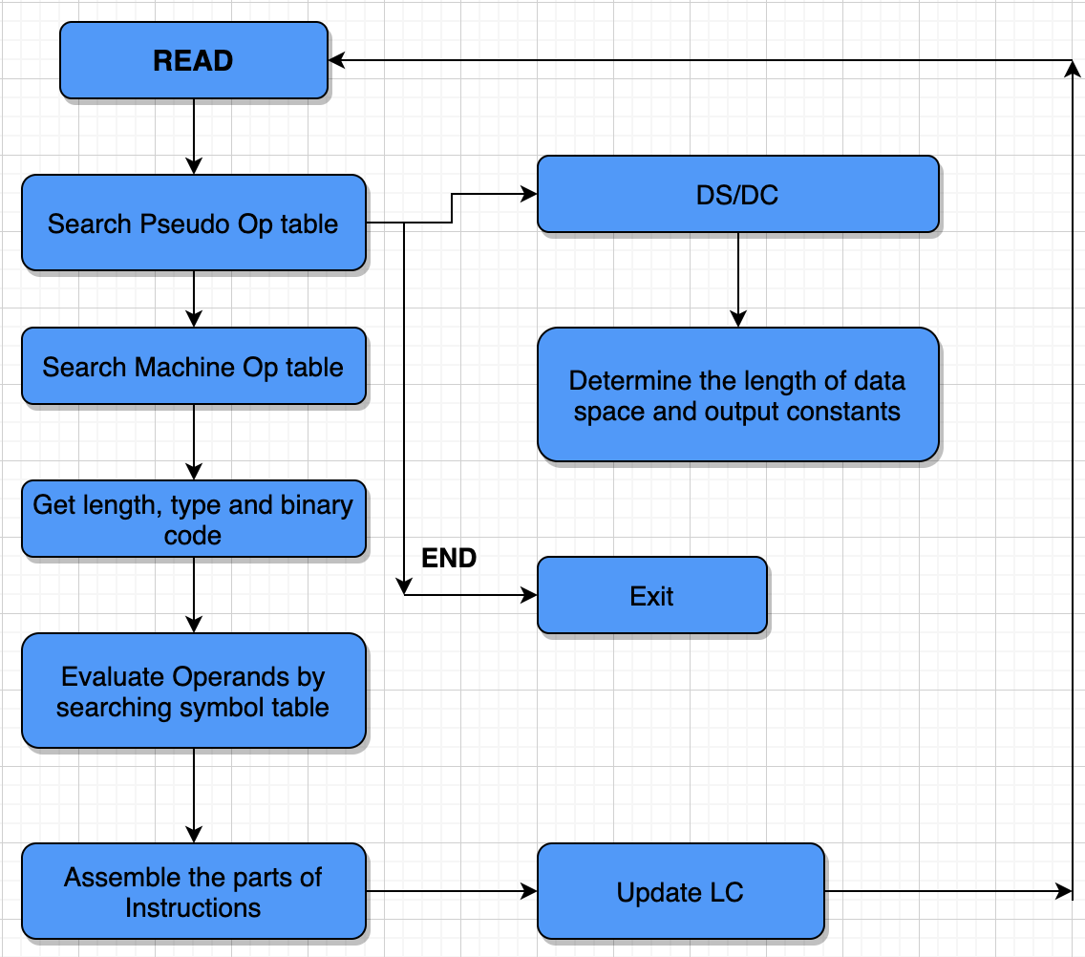
Flowchart

Slide 12
Data Structure
Operation Code Table (OPTAB) | used to map opcode to machine code. Implement using Array or HashTable
Symbol Table (SYMTAB) | used to store addresses assigned to labels. Implement using Array or HashTable
Location Counter (LOCCTR) | used in assignment of addresses

Slide 13
Implementation
Language - C++/C
For all different opcodes, an input file with 30-40 instructions is read and the operation table (OPTAB) is mapped to details such as mnemonics, format, hash table opcode.
Then Pass 1 is executed in which all lines are parsed for literals to search and the position counter is changed. Error messages are shown, if any.
All pass 1 data is entered in the Symbol Table (SYMTAB).
Pass 2 is run after the successful operation of pass 1, which gets the intermediate file generated along with the SYMTAB after pass 1 as an input.
In Pass 2, the object code is generated along with the modified SYMTAB and written as an output to a text file.
By calling their respective functions, Header, Describe, Refer, Document, Modification and End records are written as an output in a text file.
Notes:
Need to change refer to that slide

Slide 14
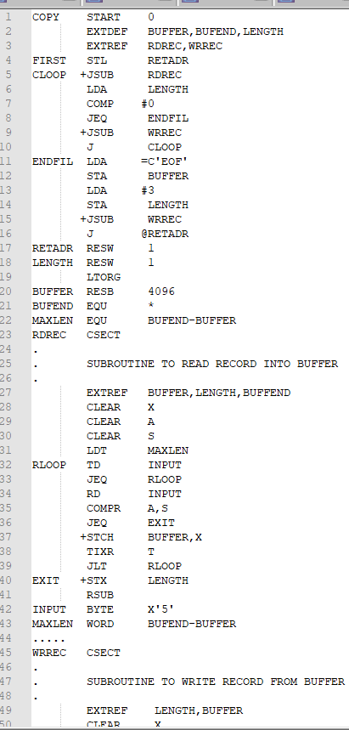
Input File

Slide 15
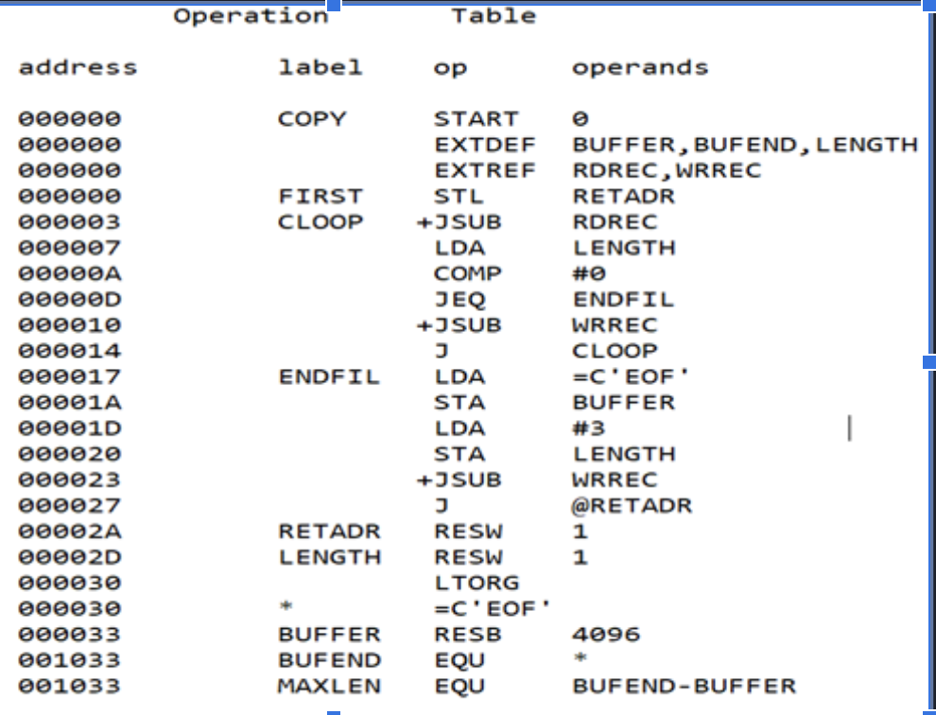
Output of Pass1: OPTAB

Slide 16
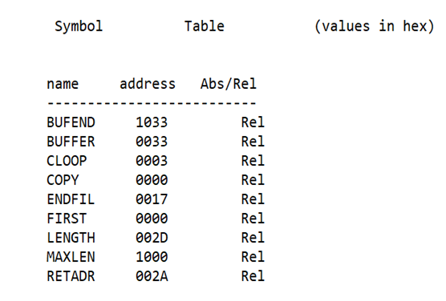
Output of Pass 1: SYMTAB

Slide 17
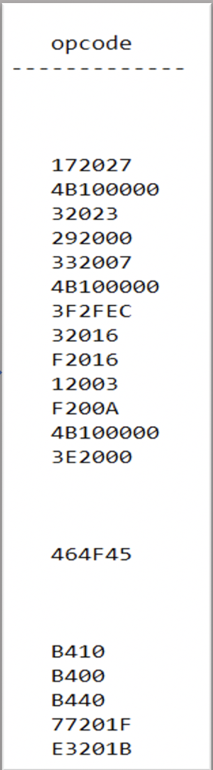
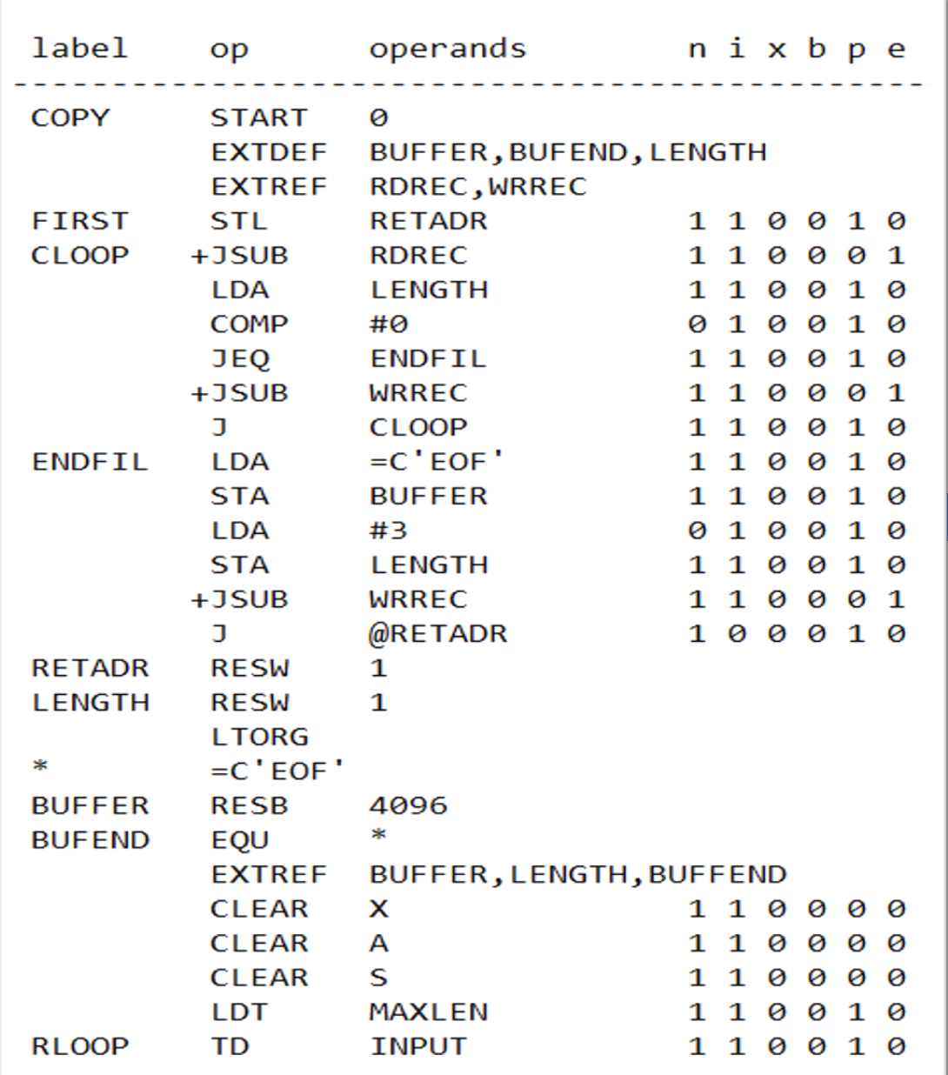
Output of Pass 2

Slide 18
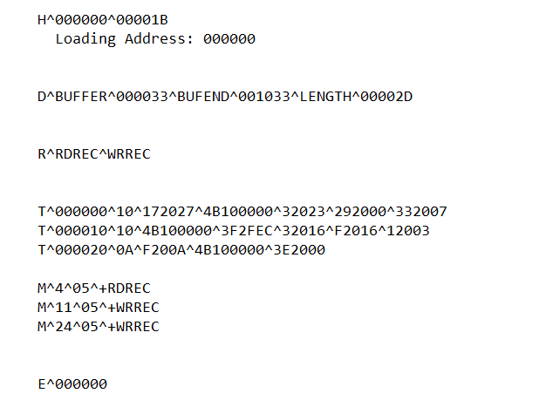
Output of Pass 2

Slide 19
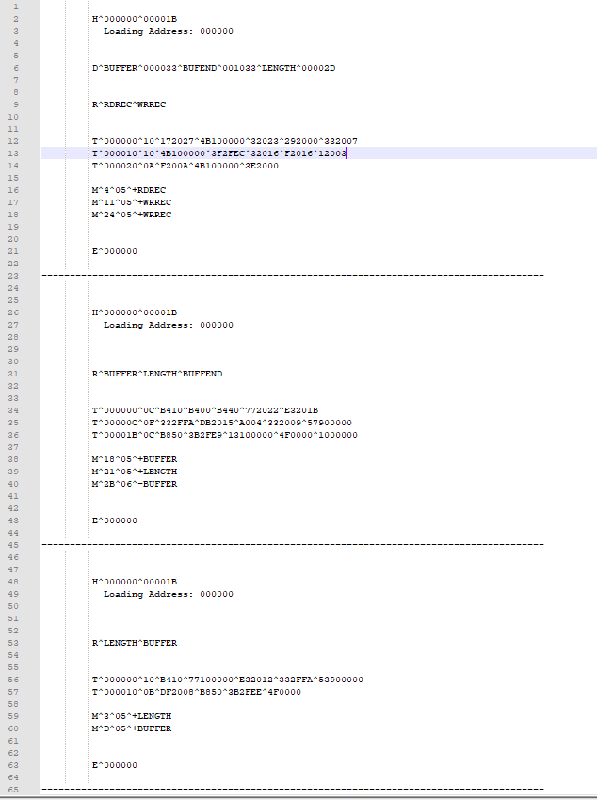

Slide 20
Improvements in implementation
Assembler will detect errors like: Undefined symbols, Symbol defined multiple times, Illegal opcode, Missing or extra opcodes
We will identify the incorrect literals of the code such as incorrect literals or input with invalid opcode.
After identifying the issue, our assembler will throw exceptions. In this way we validate our assembler is working as expected.

Slide 21
Test Scenarios for Error handling
Invalid operand
Invalid opcode
Illegal Byte
Illegal Label
Illegal Hex
EXTREF WITHOUT ‘+’
Program without END Clause
Illegal Use of Reserved Labels

Slide 22
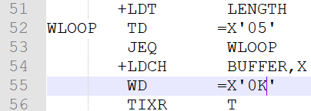
Input with Error with invalid Literal
Output with Exception Message

Slide 23
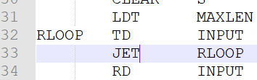
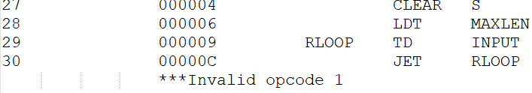
Input with Error with invalid Opcode
Output with Exception Message

Slide 24
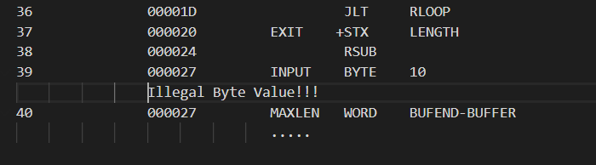
Illegal Byte
Illegal Labels

Slide 25
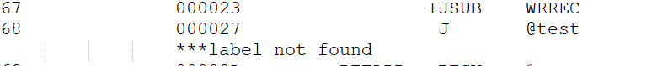
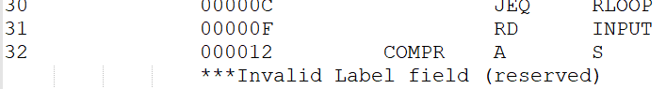
Illegal Labels

Slide 26
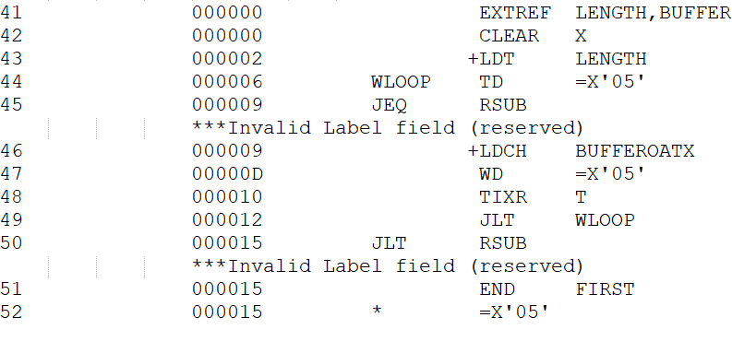
Illegal Use of Reserved Labels

Slide 27
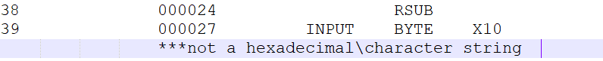
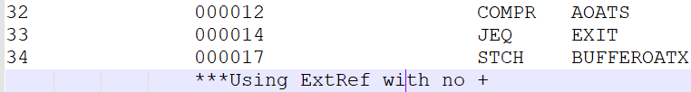
Illegal Hex
EXTREF WITHOUT ‘+’

Slide 28
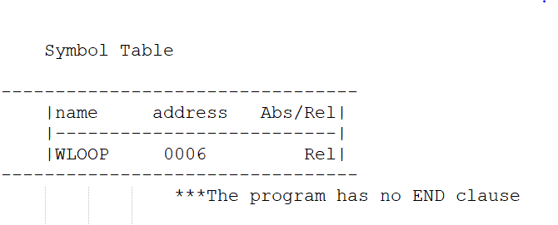
Program Without End Clause

Slide 29
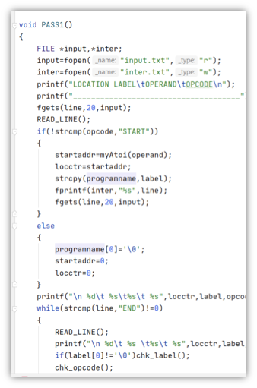
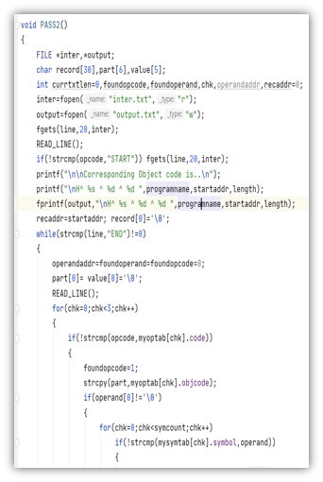
Implementation using C

Slide 30
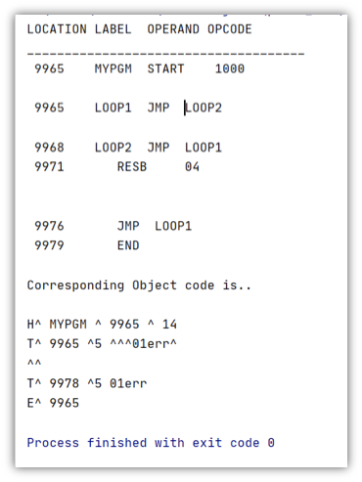
Output using C

Slide 31
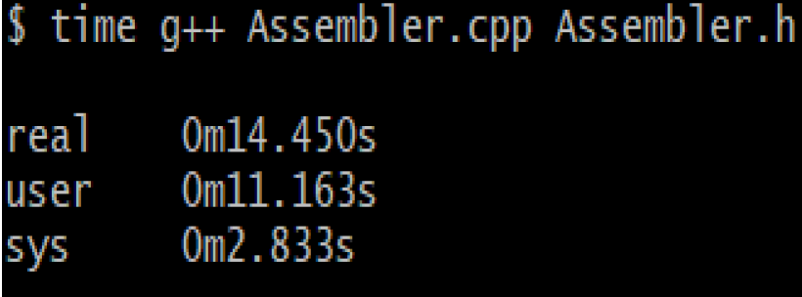
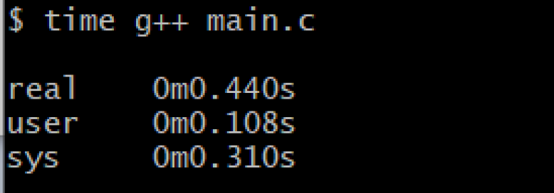
Performance
•The C code has just the basic functionalities and hence was implemented only in a single file. Whereas, the C++ code assembler has all the enhancements too and had a number of files. Hence, the execution time of both the codes differ greatly.

Slide 32

Thanks!

